Slide 1
Massachusetts Right To Know Law
Global Harmonized System
Training
Worcester Public Schools
School Nutrition Department
October 6, 2017
Developed and Provided by Lynn Rose
413-522-5525
With information from the MA Department of Labor Standards,
specifically Hilary Eustace and Nancy Comeau

Slide 2
Presentation Overview
What is the RTK law and how does it protect me?
What is a hazardous material?
How do I get exposed to hazardous materials?
How can I use information in Safety Data Sheets (SDSs) to use and manage products, and respond to product incidents?
What are the hazards of the products I work with?

Slide 3


What law governs the use of chemicals in the workplace?
Massachusetts Right to Know Law
What agency oversees RTK Law?
Governed by the MA Department of Labor Standards
Who does the law apply to?
Applies to public sector employees working in Massachusetts: people working in state, county or municipal jobs.

Slide 4
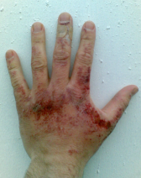
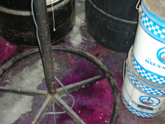
What is the Purpose of the RTK Program?
To ensure that employers and employees:
Are aware of the dangers from hazardous products.
Know how to protect yourselves to prevent exposure and injuries from hazardous products.
Know how to respond if there is an exposure or accident.

Slide 5

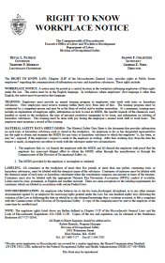
What are WPS’s RTK Responsibilities?
Employers must provide employees who are or may be exposed to hazardous chemicals with:
Access to Safety Data Sheets (SDS). Please update them when we send you new ones.
Labeling on chemical containers
RTK Workplace Notice
Training on SDSs and specific workplace chemical hazards

Slide 6
Where can I get assistance on RTK?
An employee has the right not to be discriminated against for exercising his or her rights under the law.
You may file a complaint within 180 days with the Commissioner of DLS. Contact:
RTK Program Manager
MA Department of Labor Standards
Westborough, MA
508-616-0461

Slide 7


What is a Hazardous Material?
Brainstorm
What are the characteristics that make a material hazardous?
A substance which has the capacity to injure or harm to the body by entry through absorption, ingestion, inhalation, or injection.
Toxic
Flammable/
Ignitable
A substance having a flash point below 100 degrees, is easily ignited and quick burning.

Slide 8

What is a Hazardous Material?
Acids and Bases
With a pH < 2 or >12.5
Corrosive
Produces a chemical change, and can destroy living tissue and metal on contact.
Can do serious damage in a short amount of time. The longer the contact time, the greater the damage.
Are more dangerous when concentrated.

Slide 9
pH and Corrosivity
A material is corrosive when
it is at either end of the pH Scale
< or = 2, or
> or = 12.5
pH Scale
Examples:
De-scaler
Battery acid
Examples:
Ammonia
Bleach
Oven Cleaner
1
7
14
Very
Acidic
Neutral
Very
Alkaline

Slide 10


PH and Corrosivity:
Health Effects and Precautions
Corrosive products attack living tissue and can cause severe burns.
  The extent of skin damage depends on how long the corrosive is on the skin and how concentrated the corrosive is.
  Wear chemically resistant gloves
Breathing corrosive vapors or mists can cause severe bronchial irritation.
Corrosive substances are particularly damaging to the eyes.
  Wear chemical splash goggles which are indirectly vented or other approved eye protection.

Slide 11
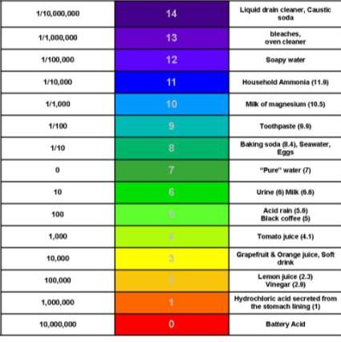
What is a Hazardous Material?
Corrosive – pH Scale
Liquid drain cleaner
Bleach, oven cleaner
Soapy water
Household ammonia (11.9)
Milk of Magnesium (10.5)
Toothpaste (9.9)
Baking Soda (8.4), Seawater, Eggs
Pure Water
Urine (6), Milk (6.6)
Acid Rain (5.0), Black coffee (5)
Tomato Juice (4.1)
Grapefruit and Orange Juice, Soft Drinks
Lemon Juice (2.3), Vinegar (2.9)
Hydrochloric Acid (from stomach)
Battery Acid

Slide 12
pH Scale of New Green Product Line
Product Name | Product Type | pH Concentrate | pH Diluted Product
Ecoscale | Descaler | 2 to 3 | 3 to 4
Eco Rinse | Rinse Aid with drying agents | 4 | 4 to 5
EcoSuds | Hand Dishwashing Soap | 7 to 8 | 6.5 to 7.5
MP-32 | Multi-Purpose Cleaner – surfaces, floors, windows and stainless steel | 4.5 to 5.1 | 6.5 to 7.5
Steramine | Disinfectant and Food Contact Sanitizer | 7 to 9 | 7
GC 210 | Sanitizer | 8.5 | 7
Brisk | HE Laundry Detergent | 10.5 | 7 to 8
Oven & Grill | Appliance Cleaner | 10 | 9.5 to 10
Converge | Automatic Dishwasher Detergent | 10.5 | 11 to 11.5
Low
High

Slide 13
pH Scale of Old Product Line
Product | pH | NFPA sand HMIS |  |  | Eyewear Splash Goggles | Gloves | Shoe Covers | Respiratory Protection/ Ventilation | Apron
 |  | Health | Flammability | Reactivity
Dish Powder Extra | 11.7 to 12 |  |  |  | X | X nitrile
Wel-rinse BAC 10 Sanitizer | 6.0 – 8.0 In neutral range but SDS says corrosive | 2 | 1
Wel-Scale Away (Lime Scale Remover) | 1.7 corrosive | 2 |  |  | X | X nitrile |  | Good ventilation | X
Oven/ Grill Cleaner | 13.7 | 3 | 1 |  | X | X - Nitrile |  |  | X
Wallop (Degreaser) | 12.5 | 1 |  |  | X | x |  | Good ventilation | X
Stainless Steel Polish | 7.1 | 2 | 1 |  | X | nitrile
Wel-Low Suds Blue | 11.7 | 2 |  |  | X | X Nitrile

Slide 14


What is a Hazardous Material?
A substance that explodes and usually releases gasses and heat when subjected to certain conditions of shock, temperature or chemical reactions.
Explosive
Any chemical that increases the burning rate of material by readily giving off oxygen or other oxidizing gas; or enters into a violent reaction.
Reactive

Slide 15



Reactives - Oxidizers
A substance that can:
Create chemical reactions that release energy.
Have corrosive properties, and can cause fire and explosions on contact with some materials.

Slide 16


Oxidizers: Storage
Store well away from:
Flammable and combustible materials as they can:
  initiate a fire, and
  can exacerbate an existing fire.
Acids and bases.
Example of new product that is an oxidizer

Slide 17
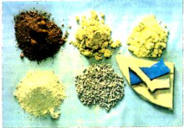
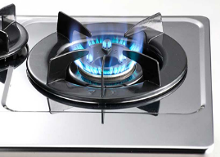

Chemical Forms: What are they?
All chemicals exist in one of three forms:
Solid
  Gas
Liquid

Slide 18

Chemical Forms: How do they change?
Chemicals are often present in more than one form.
  You can change the form of a chemical by controlling its temperature and pressure.
  They can change as you use and store them, which can make them more dangerous.
  When they change in form, their ability to get into your body also changes.
under
pressure

Slide 19
Where do I get information on chemicals hazards?

Slide 20

Global Harmonized System
(OSHA and MA Department of Labor Standards have adopted)
Uniform formats for chemical information from across the world:
Labels
Pictograms and hazard information
Safety Data Sheets (SDS)
RTK Training

Slide 21
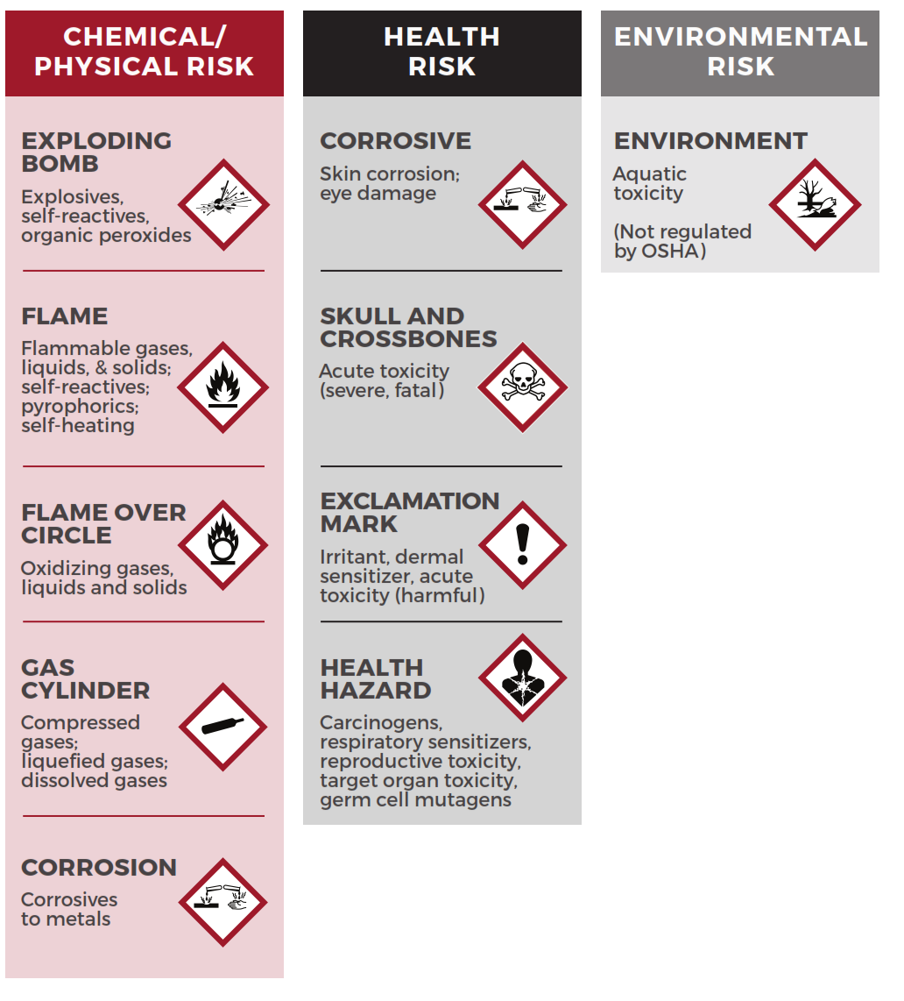
Label Requirements – “At a Glance”
Pictograms and Health and Safety Hazards

Slide 22


GHS Pictograms and Hazards
Health Hazards
–
–
–
–
–
–
Carcinogen
Mutagenicity
Reproductive Toxicity
Respiratory Sensitizer
Target Organ Toxicity
Aspiration Toxicity
This label warns that product is toxic and that gloves, goggles or
respirator may be required, depending upon your task.

Slide 23

GHS Pictograms and Hazards
Exclamation Mark
–
–
–
–
–
Irritant (skin and eye)
Skin Sensitizer
Acute Toxicity
Narcotic Effects
Respiratory Tract Irritant

Slide 24

GHS Pictograms and Hazards
Flame
–
–
–
–
–
–
Flammables
Pyrophorics
Self-Heating
Emits Flammable
Self-Reactives
Gas
Organic Peroxides
This label warns that the product can cause a fire.

Slide 25

GHS Pictograms and Hazards
Corrosion
–
–
–
Skin Corrosion/Burns
Eye Damage
Corrosive to Metals

Slide 26

GHS Pictograms and Hazards
Flame Over
– Oxidizers
Circle
This product can increase
the intensity
of a fire.

Slide 27

GHS Pictograms and Hazards
Skull and Crossbones
–
Acute
Toxicity
(fatal
or
toxic)
.

Slide 28
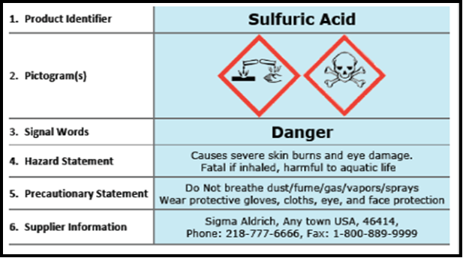
What are the new GHS Label Requirements for a
Primary Label?
(original containers)
Note use of pictograms.

Slide 29

What are the Labeling Requirements for Secondary Containers?
Must be labeled with at least the following information:
Common or trade name (“Bleach”), or a chemical name (sodium hypochlorite)
Physical and health hazard warnings in words, pictures, and/or symbols:
  health (target organ effects) - “causes lung damage”
  physical hazards – “oxidizer”, “corrosive”
Note: If a container has no label, contact your supervisor.

Slide 30
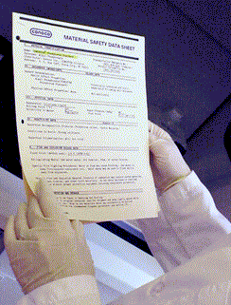
What is a Safety Data Sheet?
A primary source of information under the law on product hazards.
Developed by the manufacturer and distributed to:
  Distributors
  Employers
  Product users
WPS has compiled SDS Binders for all of the new products for each kitchen. It also contains:
  Guidance on how to interpret the SDS.
  How to take off chemically resistant gloves.
  RTK Poster

Slide 31
Order of SDS Sections
Required Format
Section 1 - Identification
Section 2 - Hazard(s) identification
Section 3 - Ingredients
Section 4 - First-aid measures
Section 5 - Fire-fighting measures
Section 6 - Accidental release measures
Section 7 - Handling and storage
Section 8 - Exposure controls/PPE
Section 9 - Physical and chemical
Section 10 - Stability and reactivity
Section 11 - Toxicological information
Section 12 - Ecological information*
Section 13 - Disposal considerations*
Section 14 - Transport information*
Section 15 - Regulatory information*
Section 16 - Other information

Slide 32
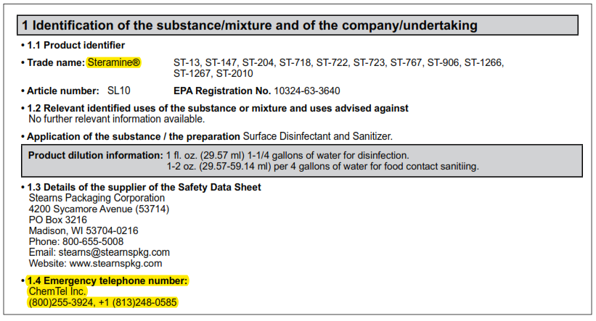
Safety Data Sheet: Format
Section 1 - Identification:
product identifier
manufacturer or distributor name and address
phone number and emergency phone number
recommended use and restrictions on use
Steramine

Slide 33
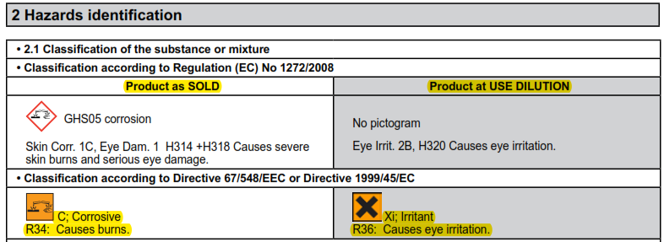

Safety Data Sheet: Format
Section 2 - Hazard(s) identification:
  all product health and safety hazards (pictogram if the product has one)
Steramine

Slide 34
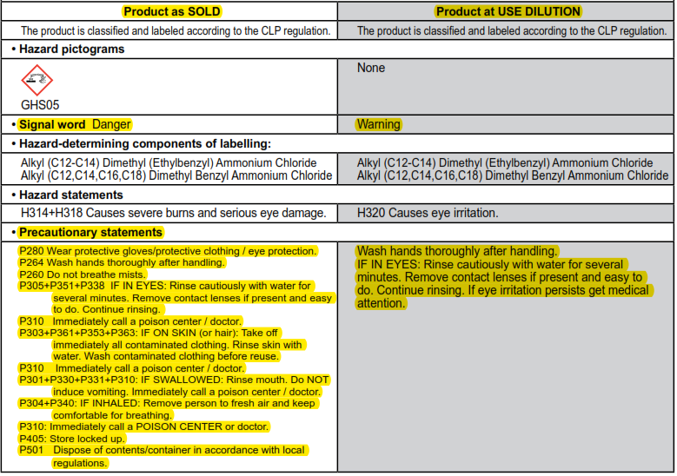
Safety Data Sheet: Format
Section 2 - Hazard(s) identification:
continued
Steramine

Slide 35

Safety Data Sheet: Format
Section 2 - Hazard(s) identification:
What types of hazards am I looking out for?
There are two types of Chemical Hazards:
Health Hazards – can cause injury or illness when you are exposed.
Physical Hazards – can create a fire or explosion when mismanaged.

Slide 36
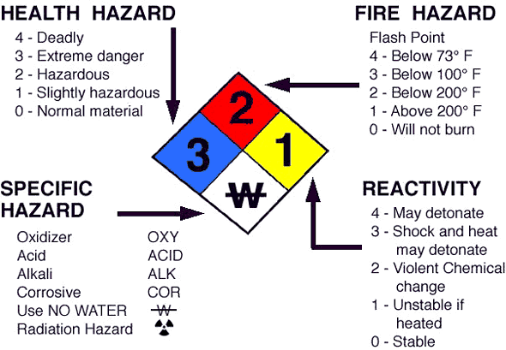
National Fire Protection Association (NFPA)
“At a Glance” Hazard Rating System
New law allows these to still be used!
Provides information on the severity of product hazards to emergency responders.
Provides ACUTE health information.
Uses the white diamond for firefighting information.
Notes:
Picture: The University of Kansas Medical Center

Slide 37
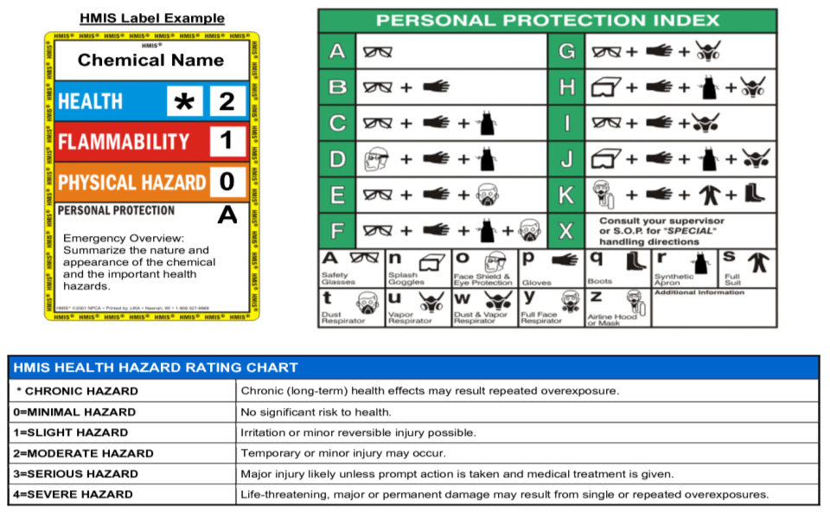
Hazardous Materials Identification System (HMIS)
Rating System for Workers- new law allows these to still be used!

Slide 38
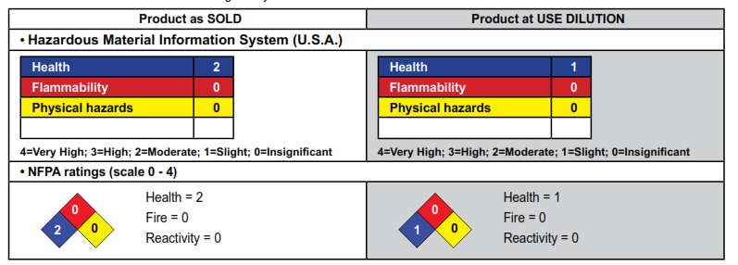
Stearamine
NFPA/HMIS Information

Slide 39
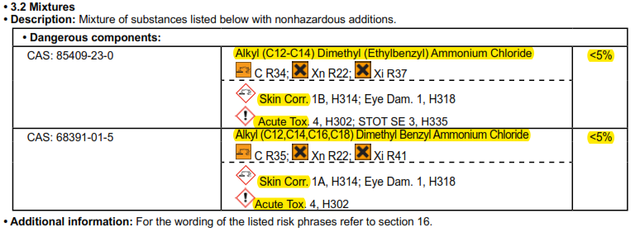


Safety Data Sheet: Format
Section 3 – Ingredient information:
information on chemical ingredients
trade secret claims
*CAS (Chemical Abstracts Service) number,
a unique identifier, important due to chemical synonyms

Slide 40
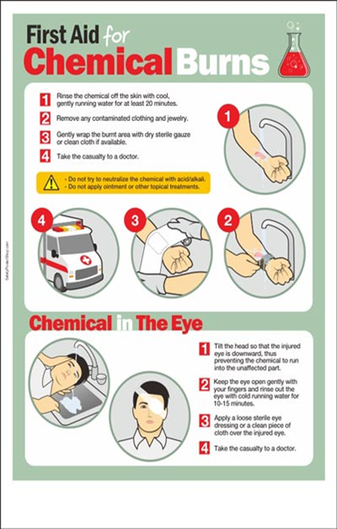
Safety Data Sheet: Format
Section 4 – First Aid Measures:
important symptoms / effects - acute, delayed
required treatment
Although it is important to send the SDS to the hospital or doctor with the person who has been exposed,
these guidelines are designed for you and your co-workers to use!

Slide 41
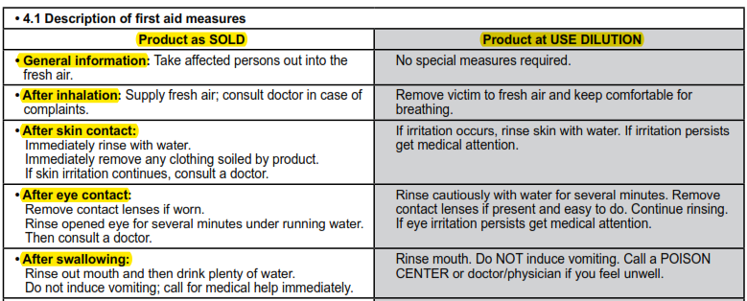
Safety Data Sheet: Format
Section 4 – First Aid Measures:
Steramine

Slide 42
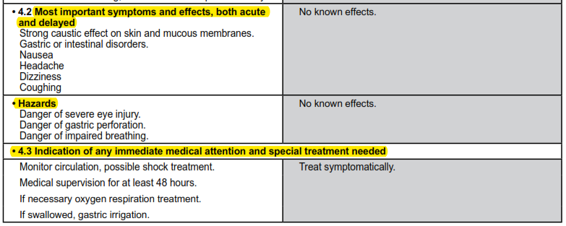
Safety Data Sheet: Format
Section 4 – First Aid Measures: continued
Steramine

Slide 43



Corrosives: Emergency Wash Equipment
The emergency wash facilities must:
Be located within the immediate work area within ten seconds of travel or within one hundred feet.
Provide the fifteen minute flow of tepid water at a minimum of 0.4 gallons per minute.
You can use an eyewash bottle to get you to a sink. Check expiration date.
Eyewash Station
Portable Eyewash

Slide 44
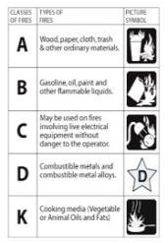
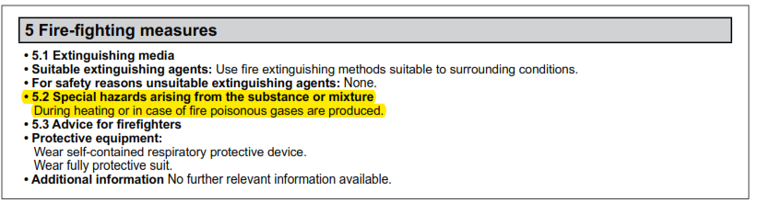
Safety Data Sheet: Format
Section 5 - Fire-Fighting Measures:
flammability of product
extinguishing techniques & equipment
chemical hazards from fire
Flashpoint, flammability limits

Slide 45
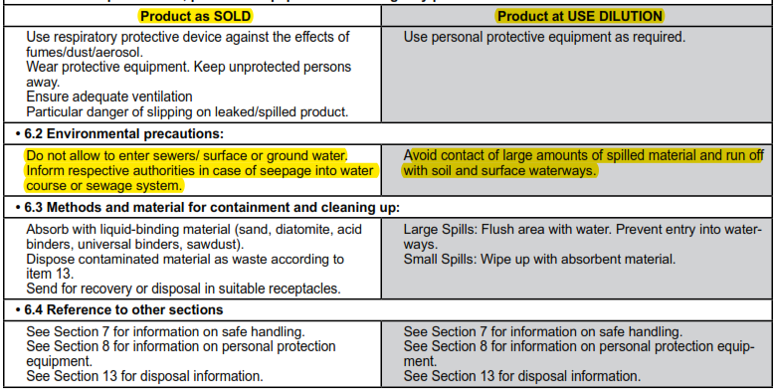
Safety Data Sheet: Format
Section 6 - Accidental Release Measures:
emergency procedures
personal protective equipment
methods of containment and cleanup
Steramine

Slide 46
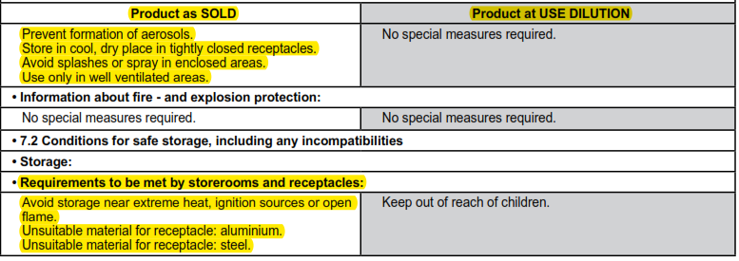
Safety Data Sheet: Format
Section 7 – Handling & Storage:
Chemical compatibility
Special storage equipment
Safe handling practices
Steramine

Slide 47
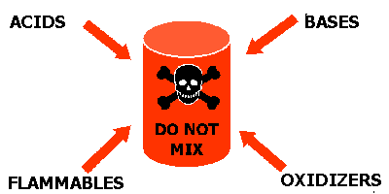
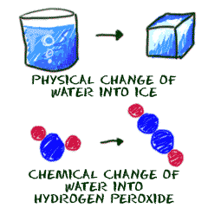
Safety Data Sheet: Format
Section 7 - Handling and Storage
See also other SDS sections:
Section 10 - Stability and Reactivity (Check compatibility)
Section 9 - Physical and Chemical Properties (check pH for corrosivity)

Slide 48
Handling and Storage
Incompatibilities – need to store by hazard category:
Corrosives - Acids
e.g. de-scaler
Corrosives - Bases
e.g. lye, dishwasher detergent
Oxidizers/Reactives
e.g. bleach, peroxides
Flammables
e.g. degreaser, alcohol based products
Poisons
e.g. degreaser, stainless steel polish

Slide 49
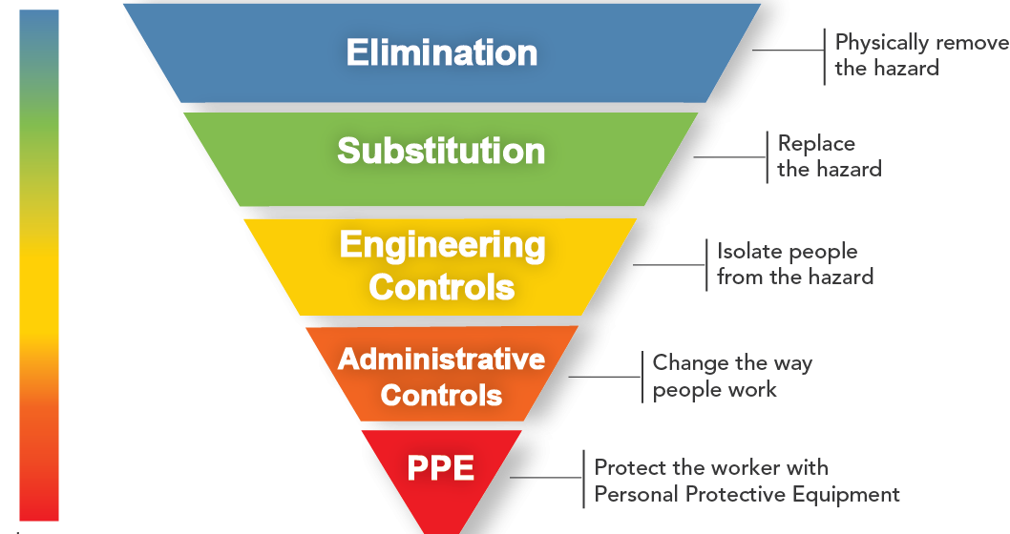
Safety Data Sheet: Format
Section 8 - Exposure Controls/Personal Protection
Hierarchy of Controls
Eliminate bleach,
Use less hazardous sanitizer, oven cleaner
Use vent on the stove to remove smoke
Dilute products according to directions
Use gloves, goggles, apron, etc.

Slide 50
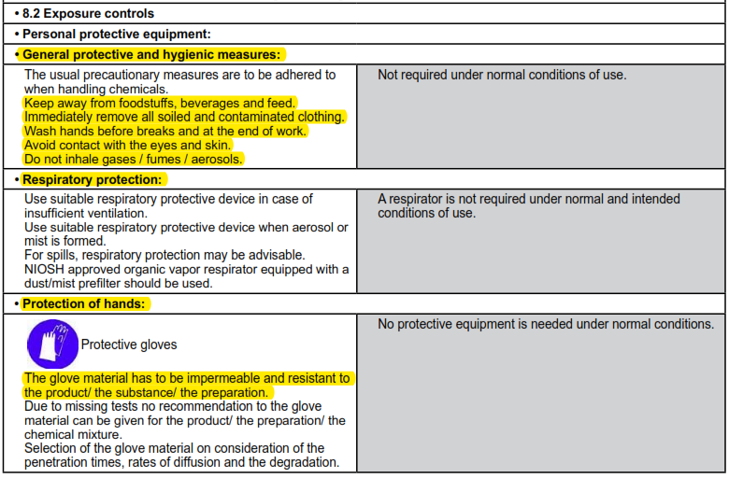
Safety Data Sheet: Format
Section 8 - Exposure Controls/Personal Protection
Hierarchy of Controls
Engineering Controls (ventilation equipment)
Work practices
Personal protective equipment
Steramine

Slide 51
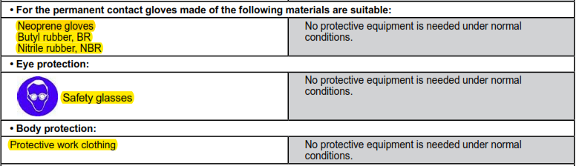
Safety Data Sheet: Format
Section 8 - Exposure Controls/Personal Protection: continued
Steramine
Chemical splash goggles

Slide 52

Safety Data Sheet: Format
Section 8 - Exposure Controls/Personal Protection
Engineering Control - used for pollution control.
Example in Kitchen – Stove Hood

Slide 53
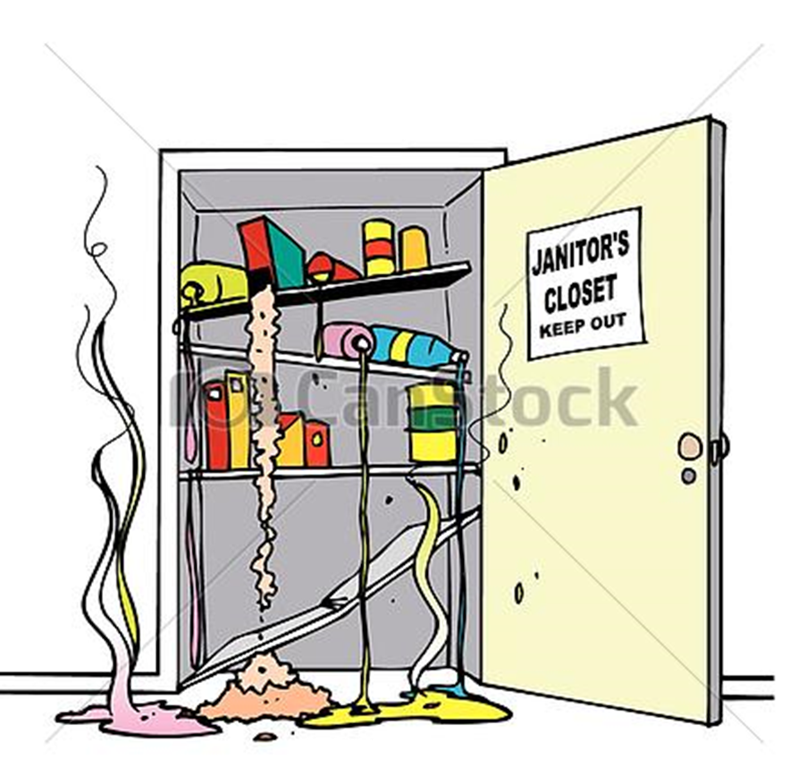
Safety Data Sheet: Format
Section 8 - Exposure Controls/Personal Protection
Work Practices – how to protect yourself!
  Read the label and safety data sheet before using a new product.
  Wear Personal Protective Equipment (PPE), if required.
  Use ventilation if required.
  Pour and dilute the product properly (more is not better!).
  Use as directed.
  Close the container lid and store properly.

Slide 54








Safety Data Sheet: Format
Section 8 - Exposure Controls/Personal Protection
Personal Protective Equipment (PPE)
  Gloves
  Booties/Boots
  Respiratory protection
  Face shields
  Aprons/Suits
  Goggles/Safety Glasses

Slide 55


Exposure Controls: PPE - Gloves
Different types of protection against:
Corrosives and Toxic materials
Physical Hazards (e.g. cuts, burns)
Infectious Agents
Check for type needed:
SDS sheet or label
Safety supplier
(Note: do not use latex due to allergies & not chemical resistant)

Slide 56
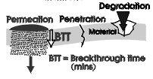
Exposure Controls: PPE - Gloves
Precautions:
Break Through Time
  A reusable or disposable glove may protect against a chemical, but not for the length of time your hands might be in contact with the chemical.
Damage
  A glove may rip/tear under your work conditions.
Factors that can affect the glove’s protection against chemicals

Slide 57
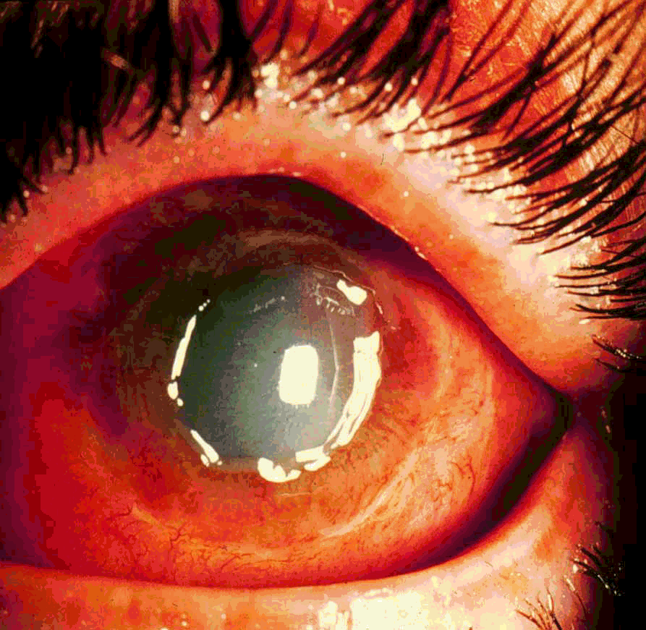
Exposure Controls: PPE - Eye Protection
Eyes can be exposed to chemicals and particles in several ways:
  Chemicals and particles can harm eyes directly.
  Eyes can absorb chemicals from mists and vapors.
  Chemicals can get trapped behind contact lenses.
Cornea damaged by chemical splash
You need to flush your eyes for 15 minutes if you get chemicals in them.

Slide 58
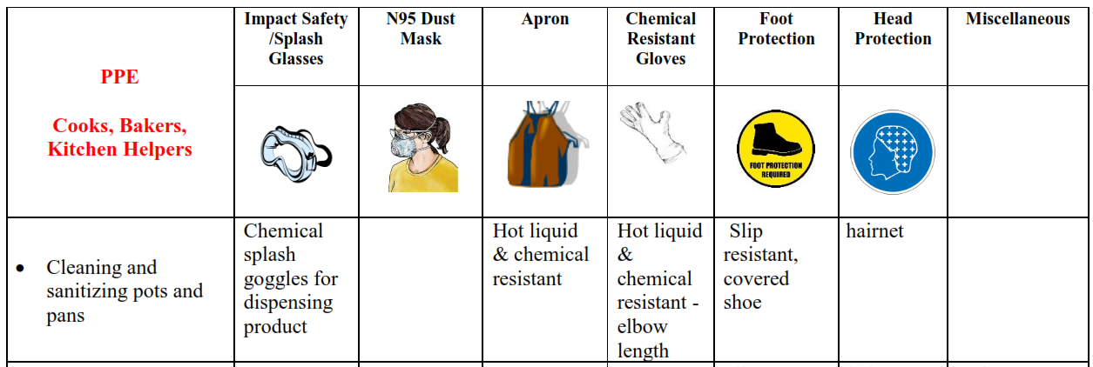
Personal Protective Equipment (PPE)
WPS will provide a PPE chart based on a “Hazard Assessment” of work tasks - Examples:
  Gloves and goggles - used for corrosive cleaning products.
  Cut-resistant gloves - used when cleaning deli slicer.
  Closed-toe shoes - used when handling hot items or heavy items.
The final “Hazard Assessment for PPE” will be located in the RTK Binder. An example:

Slide 59
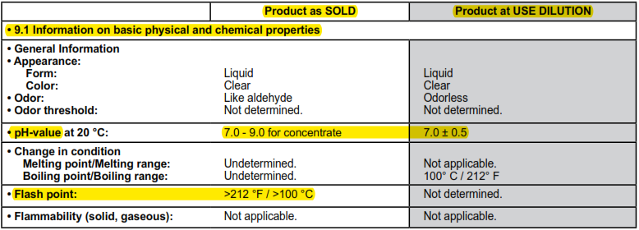
Safety Data Sheet: Format
SECTION III – PHYSICAL DATA
Section 9 - Physical and Chemical Properties:
chemical's characteristics – examples of key information:
  What is the pH?
  Does it sink or float in the air or water?
  How fast does it evaporate?
Steramine

Slide 60
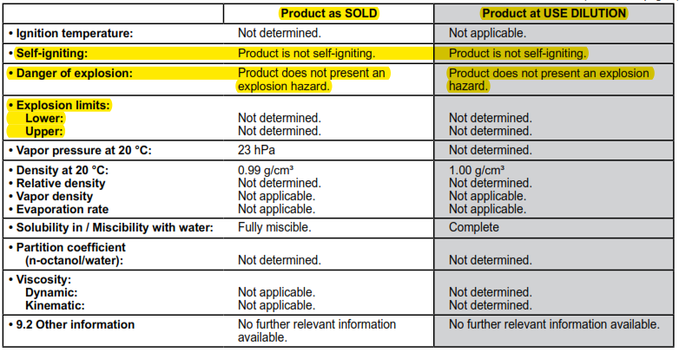
Safety Data Sheet: Format
SECTION III – PHYSICAL DATA
Section 9 - Physical and Chemical Properties: continued
Steramine

Slide 61
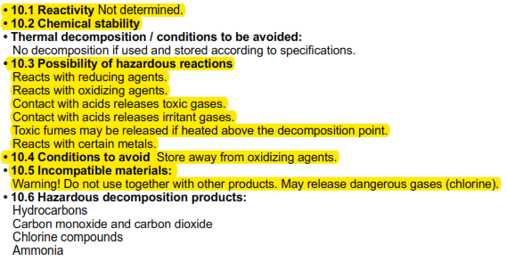
Safety Data Sheet: Format
Section 10 - Stability and Reactivity:
chemical stability
possibility of hazardous reactions – compatibility with air, water or other chemicals

Slide 62
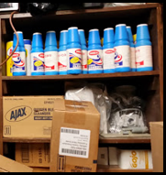

Reactivity
Reactivity is the conditions under which a chemical will change form (a solid to a gas, or a liquid to a vapor) either by itself or in contact with another material.
Reactive materials maybe corrosive, and may:
Produce 2. React 3. Cause a fire
toxic fumes violently

Slide 63
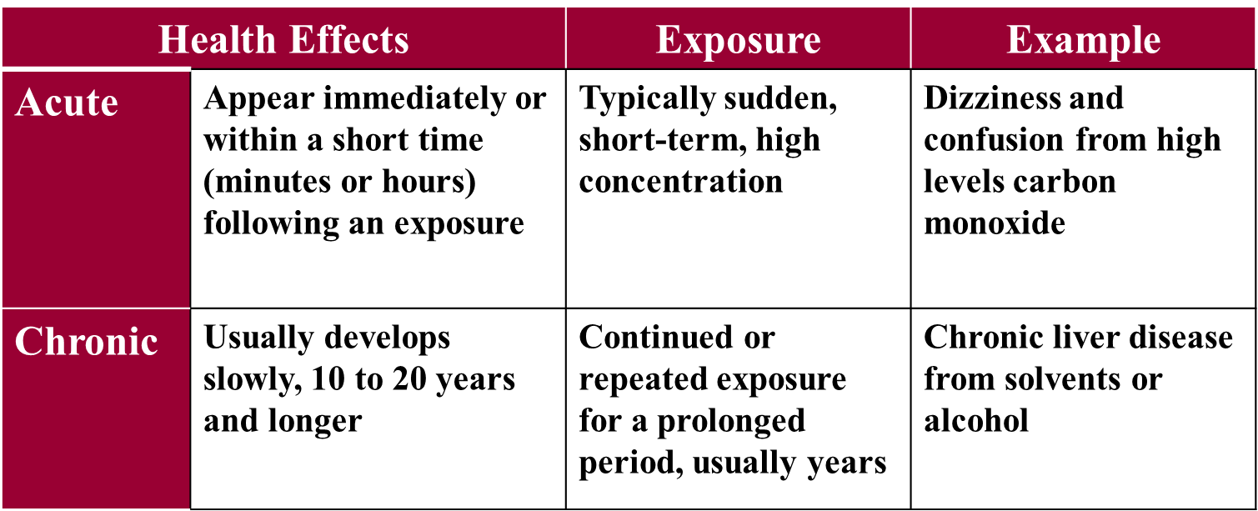
Safety Data Sheet: Format
Section 11 - Toxicological Information:
measures of toxicity
acute and chronic effects
______________________________________________________________________________
Exposures impact the body based on how long (duration), and how often (frequency) you are exposed:

Slide 64
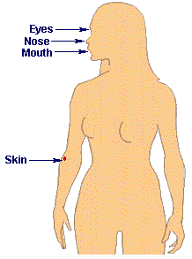
Safety Data Sheet: Format
Section 11 - Toxicological Information:
Routes of Exposure – How do chemicals get into your body?????
Breathing (Inhalation)
Swallowing (Ingestion)
Piercing of skin (Injection)
Skin Absorption
Eye Absorption

Slide 65

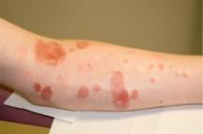
Safety Data Sheet: Format
Section 11 - Toxicological Information:
Symptoms – how do you know if you have been exposed??
You Experience Symptoms
  Example respiratory irritant:
    coughing
    sneezing
    asthma
  Example skin irritant:
    itching
    rash
    burning

Slide 66

Clues to determine if you have been exposed: Odor
Odor Threshold: concentration at which material can be detected by most people.
You are NOT necessarily safe just because you can’t smell a chemical.
  Your senses maybe exhausted (e.g. oil based paint).
  Odor threshold may be lower than safe level (e.g. carbon monoxide).
You are NOT necessarily at risk just because you can smell a chemical.
  Odor threshold may be higher than safe level.
  Chemicals of low toxicity can have very strong odors (e.g. mercaptans are added to natural gas).

Slide 67
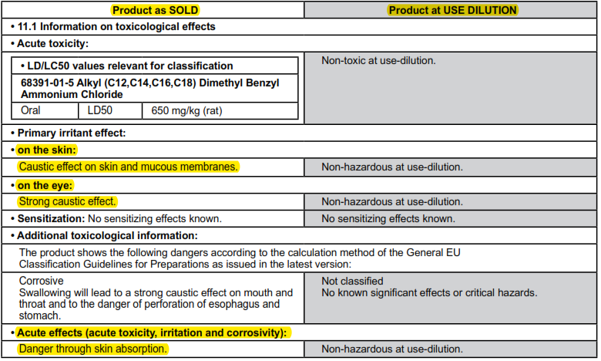
Safety Data Sheet: Format
Section 11 - Toxicological Information:

Slide 68
Safety Data Sheet: Format
Section 12 - Ecological information*
Section 13 - Disposal considerations*
Section 14 - Transport information*
Section 15 - Regulatory information*
Section 16 - Other information, date of preparation or last revision
*Note: Since other agencies regulate this information, OSHA does not enforce these sections 12-15

Slide 69
Questions????
One last note – Under RTK Law, employees may not bring their own chemical products to the workplace without cooperation of their employer because it would require training, proper labels and Safety Data Sheets.

